Slide 1
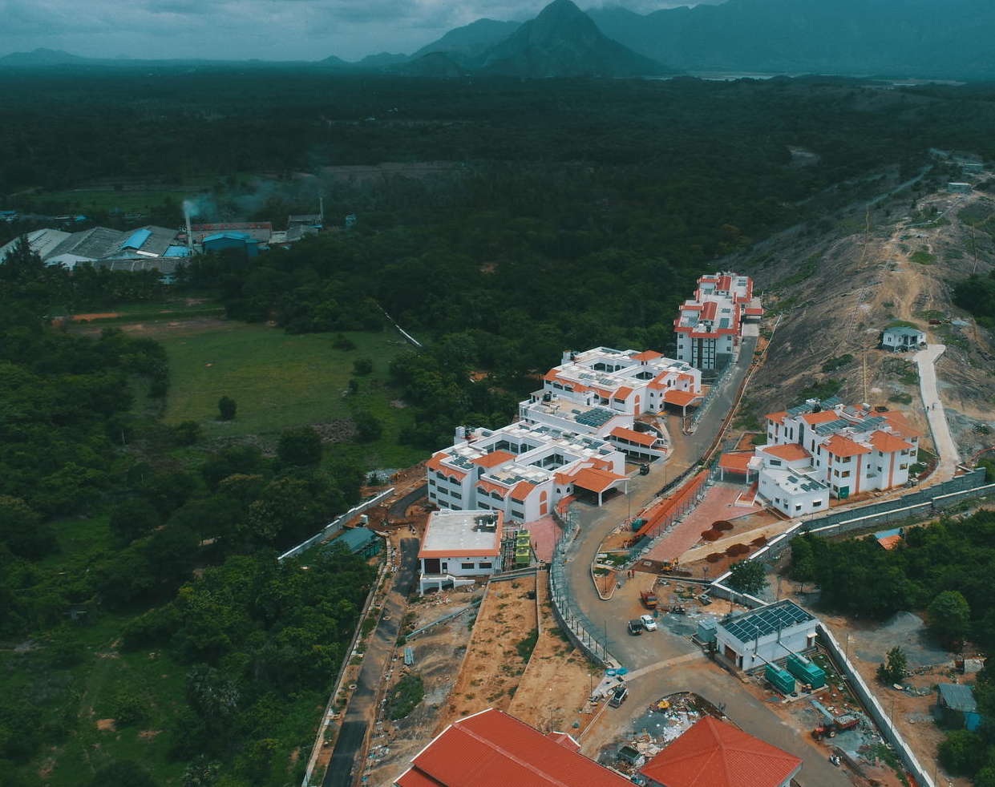
Indian Institute of Technology
Palakkad

Slide 2
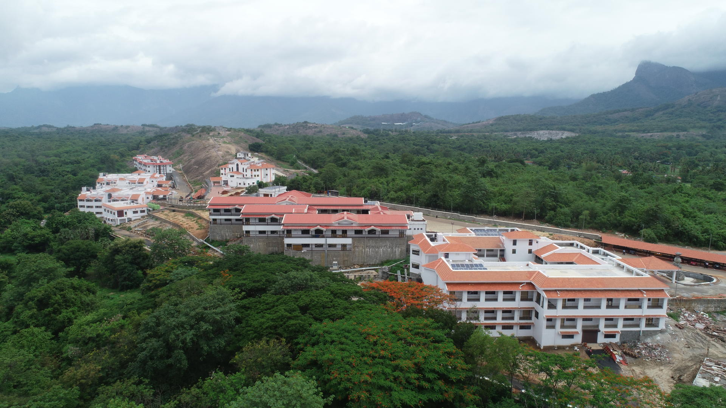
Indian Institute of Technology Palakkad (IIT Palakkad or IIT PKD) is a public autonomous engineering and research institute located in Palakkad, Kerala. IIT Palakkad was established in 2015 with streams such as Computer Application and IT, Engineering and Architecture and sciences. IIT Palakkad currently has two campuses –Nila Campus at kanjikode and a temporary facility at Ahalia Integrated Campus, Kozhippara. IIT PKD is fully residential with separate hostels for girls and boys. There are five boys hostel and one girls hostel

Slide 3

Courses
Computer Science and Engineering
Mechanical Engineering
Information and Coding Theory
Artificial Intelligence
Software Engineering
Game Theory

Slide 4
END

